Slide 1
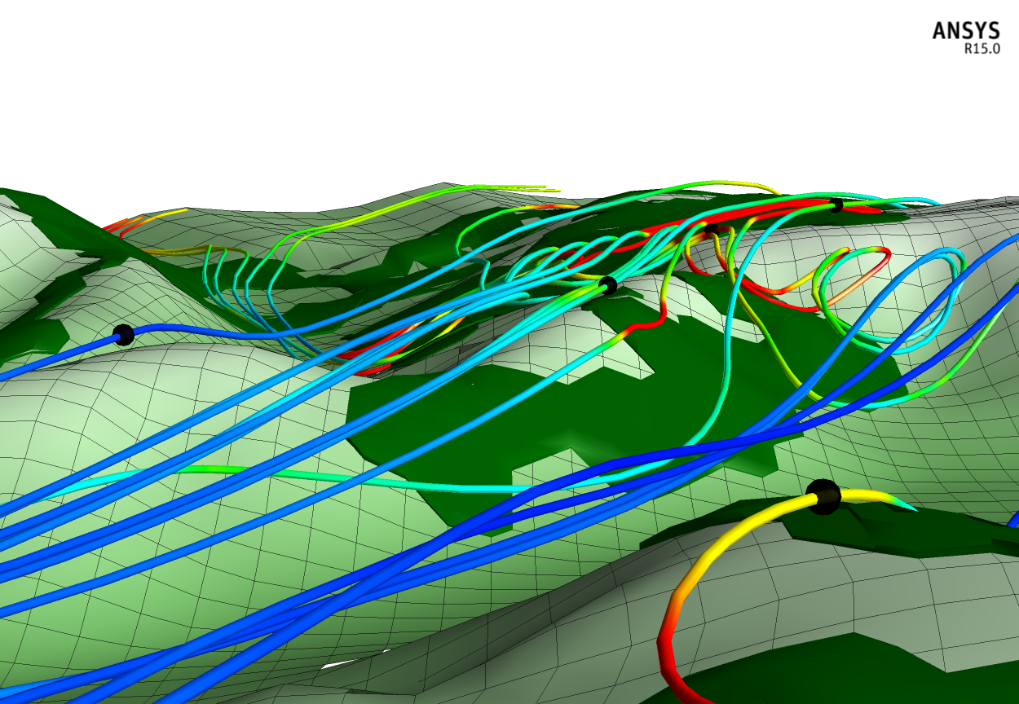
Evaluating The Wind Resource From Rotor Equivalent Wind Speeds
Christiane Montavon
Lead Consultancy Engineer
WindModeller

Slide 2
Outline
Definitions
Rotor equivalent wind speed (REWS) and terrain effects
Sensitivity to changes in stability conditions
Impact on gross annual energy production (AEP)
Notes:
30min presentation!

Slide 3
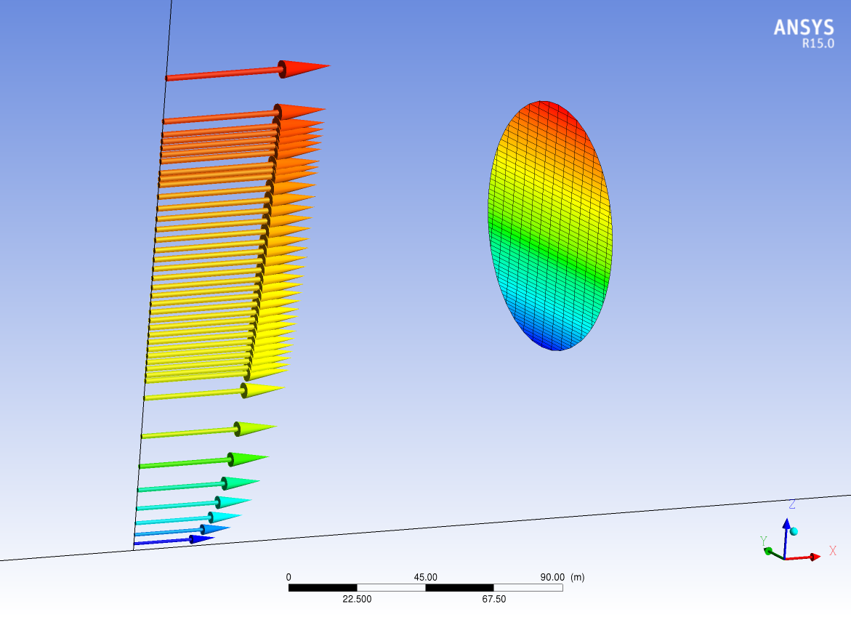
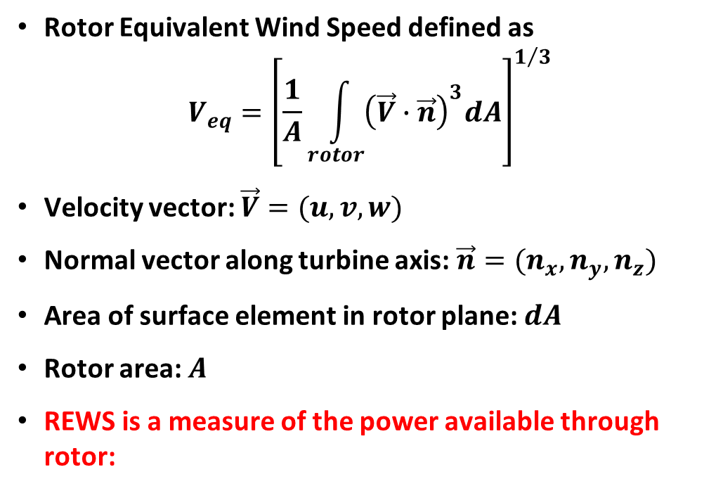
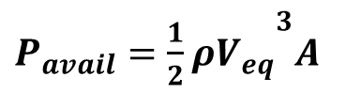
Definition of Rotor Equivalent Wind Speed (REWS)
Rotor Equivalent Wind Speed defined as
$$V_{eq}={\left[\frac{1}{A}\int_{rotor}{{\left(\vec{V}∙\vec{n}\right)}^{3}dA}\right]}^{1/3}$$
Velocity vector: $\vec{V}=(u,v,w)$
Normal vector along turbine axis: $\vec{n}=(n_{x},n_{y},n_{z})$
Area of surface element in rotor plane: $dA$
Rotor area: $A$
REWS is a measure of the power available through rotor:
${{P_{avail}=\frac{1}{2}ρV}_{eq}}^{3}A$

Slide 4
2D case

Slide 5
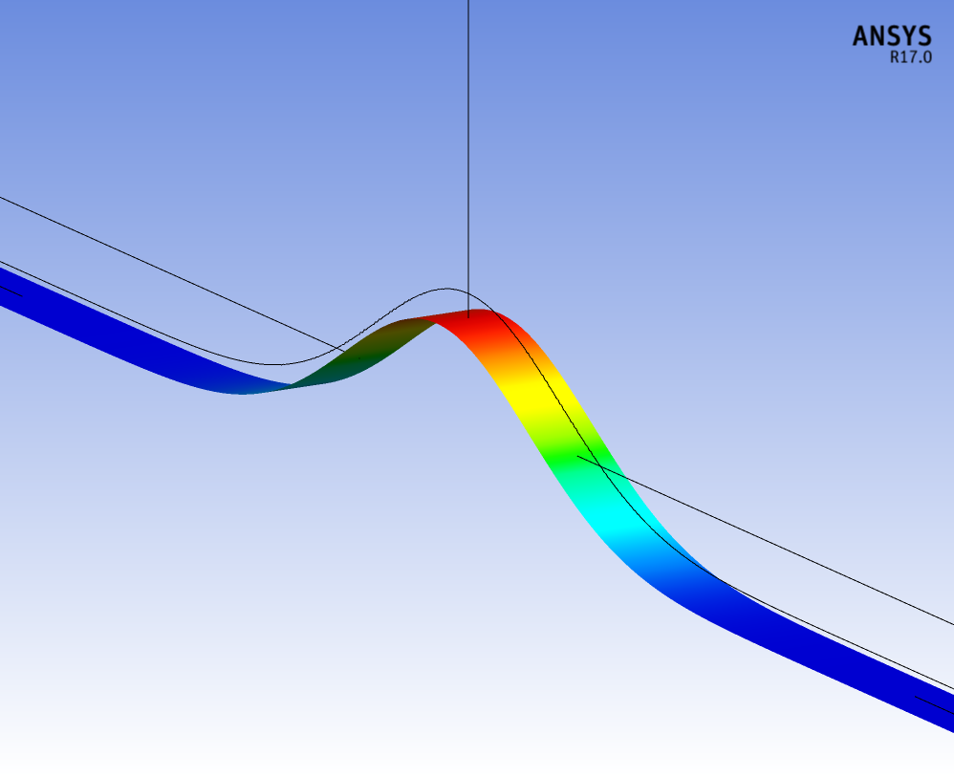
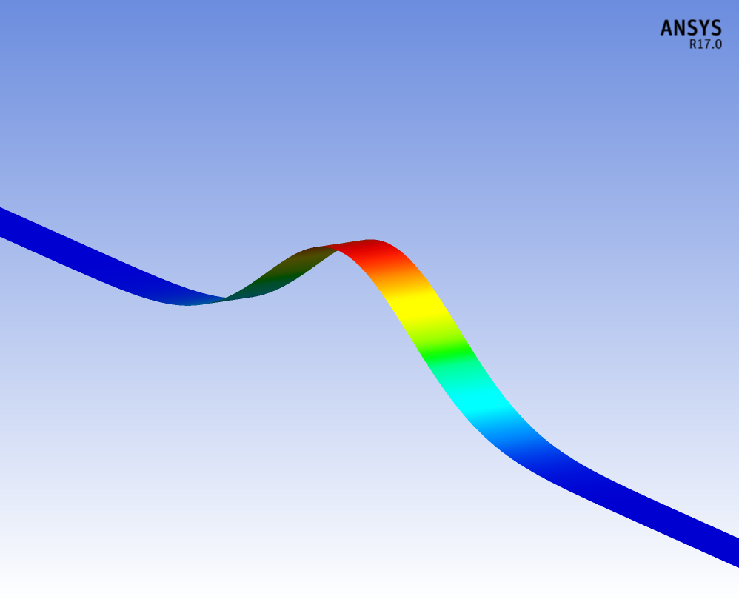
REWS and terrain, 2D case
Analysis carried out for 2D case, Gaussian hill profile:
Half width W = 500m
Height H, varying (100-500m)
For a range of stability conditions
Purely neutral
Adiabatic ground (neutral surface layer) with
Stable conditions above boundary layer (ISO standard atmosphere)
Inversion layer + low level jet
H
W
Notes:
Dx = 20m,
Dz1 = 1m

Slide 6
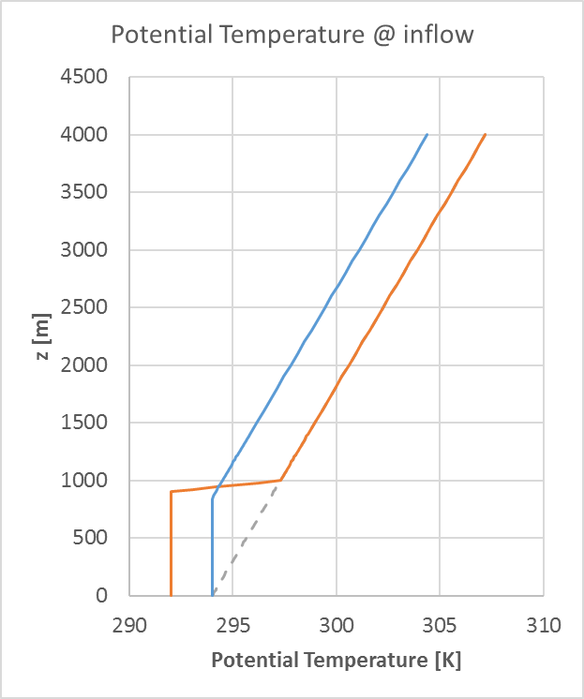
Simulation set up
Roughness: 0.05m
Upstream velocity profile: log law, 7 m/s @ 58.5m
2-equation RANS Turbulence model: SST, standard constants
Three different stability conditions
Purely neutral (equivalent to constant potential temperature throughout)
Neutral within boundary layer, ISO stable above (potential temperature gradient of 3.3 K/km)
With inversion at 1000m
CFD solver: ANSYS CFX, in WindModeller
Note: all 3 cases still using adiabatic conditions at the ground (i.e. neutral surface layer)

Slide 7
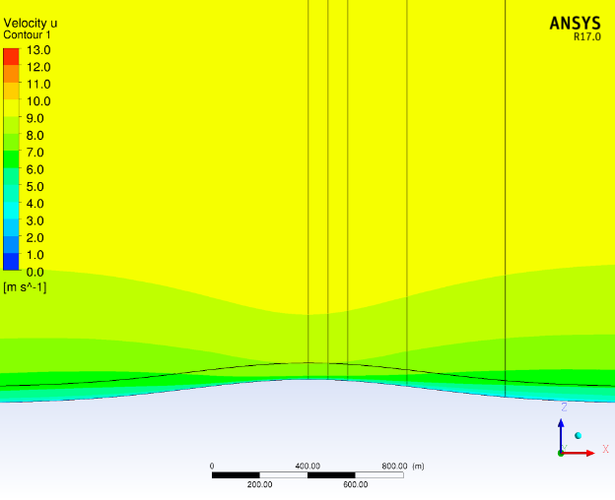
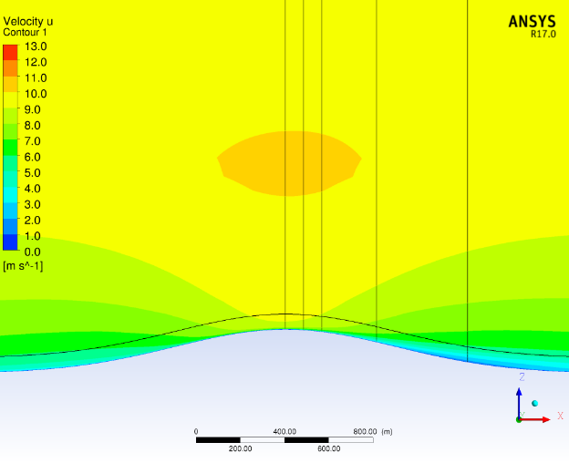
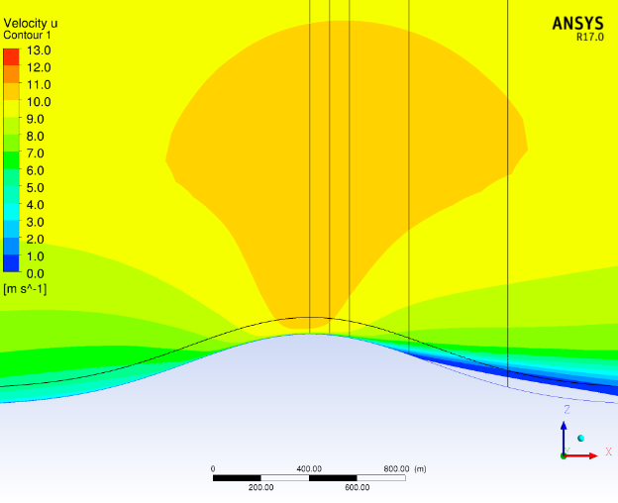
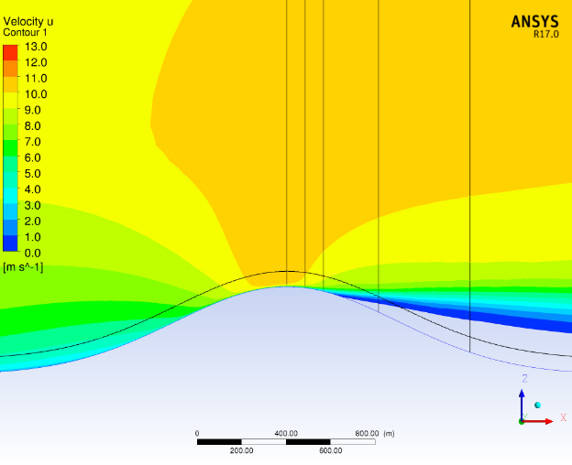
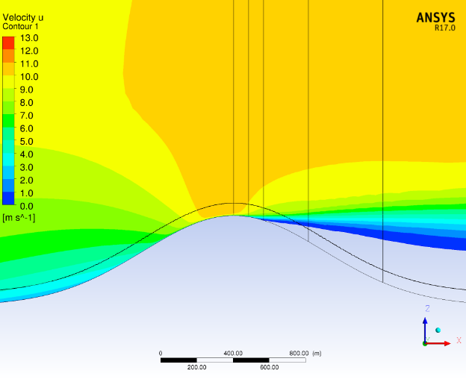
Purely neutral results, Hill half-width of 500m
H = 100m, max slope 12%, ~7°
H = 200m, max slope 24%, ~13.5°
H = 300m, max slope 36%, ~20°
Separated flow region below red line
U velocity component
Vertical lines @ hill top, 1D, 2D, 5D and 10D downstream of hill top (based on D = 82.4m)
Terrain following line indicates hub height 70m above ground level (AGL)
Flow separation occurs for hill height of 300m and above. Note: Kaimal and Finnigan → critical angle for flow separation in 2 dimensional case is ~18°.
H = 400m, max slope 48%, ~26°
H = 500m, max slope 60%, ~31°
Separated flow region below red line
Separated flow region below red line
Notes:
Critical angle for flow separation, 2D case, is about 18deg [Kaimal and Finnigan]
Note: assumed D = 82.4m (turbine diameter)

Slide 8
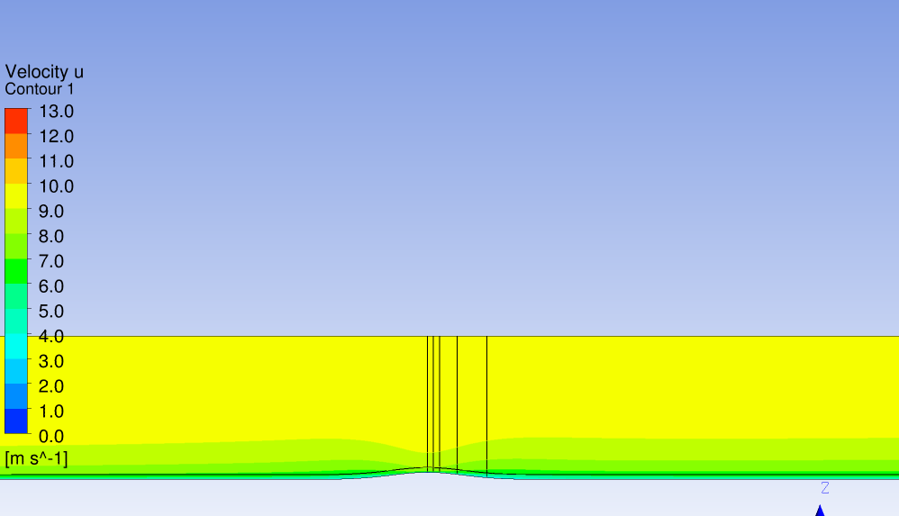

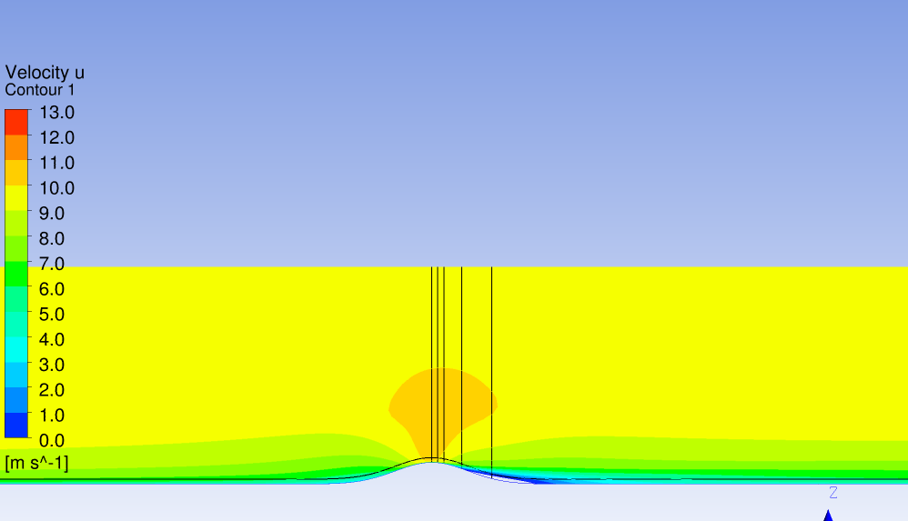
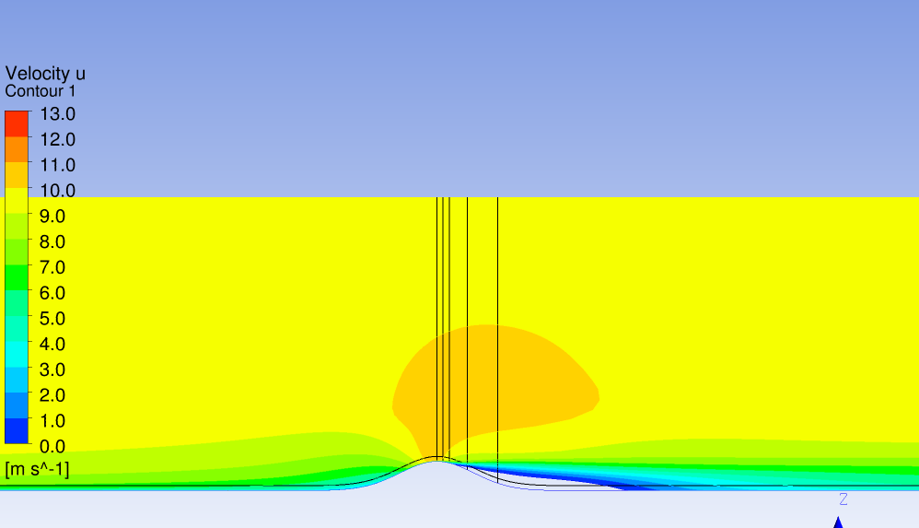
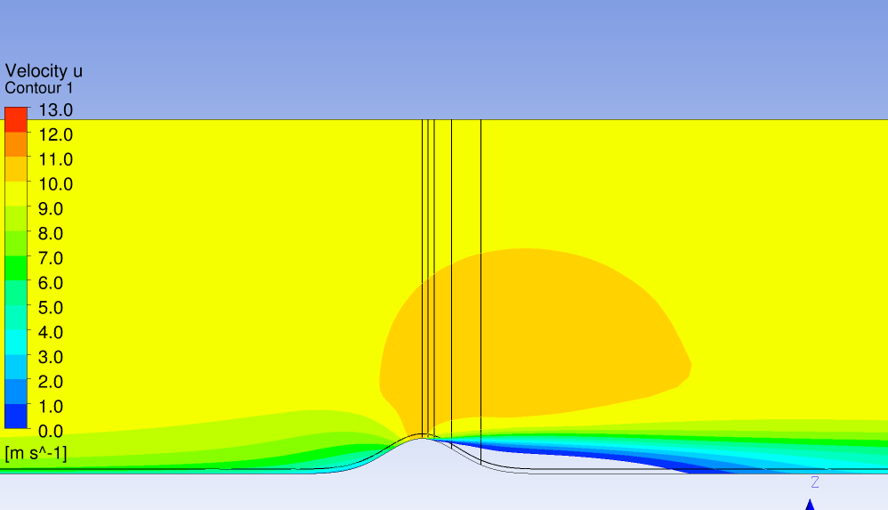
As previous slide, zoomed out
H = 100m, max slope 12%, ~7°
H = 200m, max slope 24%, ~13.5°
H = 300m, max slope 36%, ~20°
U velocity component
Vertical lines @ hill top, 1D, 2D, 5D and 10D downstream of hill top
Terrain following line indicates hub height 70m above ground level (AGL)
Flow separation occurs for hill height of 300m and above. Note: Kaimal and Finnigan → critical angle for flow separation in 2D case is ~18°.
H = 400m, max slope 48%, ~26°
H = 500m, max slope 60%, ~31°
Notes:
Critical angle for flow separation, 2D case, is about 18deg [Kaimal and Finnigan]
Note: assumed D = 82.4m (turbine diameter)

Slide 9
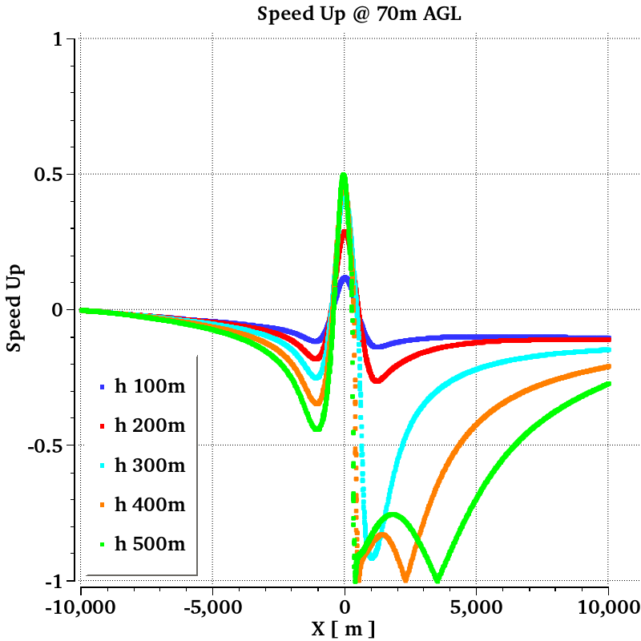
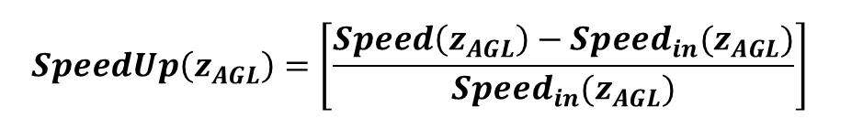
Purely neutral results, Hill half-width of 500m
Speed Up @ 70m AGL vs distance from hill top, for various hill heights
Blockage upstream of hill top increases with hill height
Speed up at hill top increases with hill height, seems to saturate at a max value of 50%
Separation visible at hub height for hill heights of 400 and 500m
Relatively long separation bubble, recovers slowly downstream of the hill.
$$SpeedUp\left(z_{AGL}\right)={\left[\frac{{Speed\left(z_{AGL}\right)−Speed}_{in}(z_{AGL})}{{Speed}_{in}(z_{AGL})}\right]}^{}$$

Slide 10
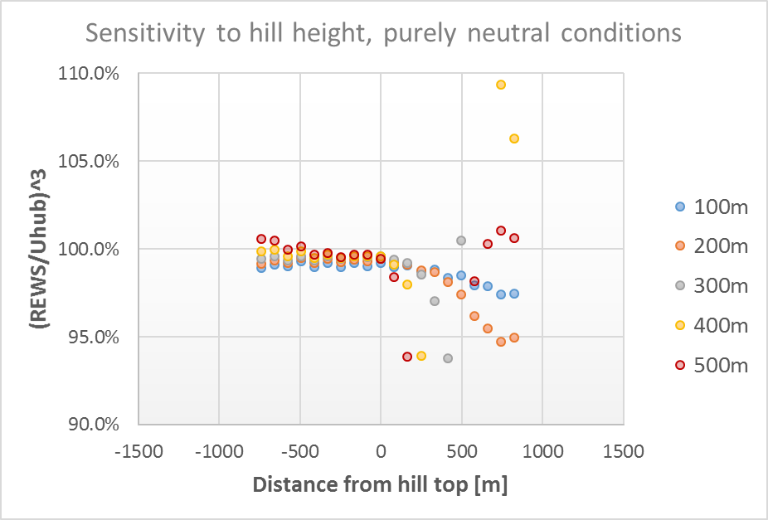
Purely neutral results, Hill half-width of 500m
Ratio of available energy through rotor from REWS and from hub wind speed, plotted vs distance from hill top, for various hill heights
Except for hill height of 500m, ratio generally just below 1 upstream of the hill top
Downstream of the hill top, ratio monotonically decreases for cases without flow separation. Stronger decrease for higher hill height.
Cases with separation show reduction of ratio to ~ 0.94, before the ratio jumps to very high values (beyond scale) when the hub height gets in separated flow region.
Available energy from hub height wind speed can exceed available energy in flow (from REWS) by up to ~ 5-6% in the wake of the hill.
Cases where REWS significantly exceeds Uhub correspond to locations in separated flow region.

Slide 11
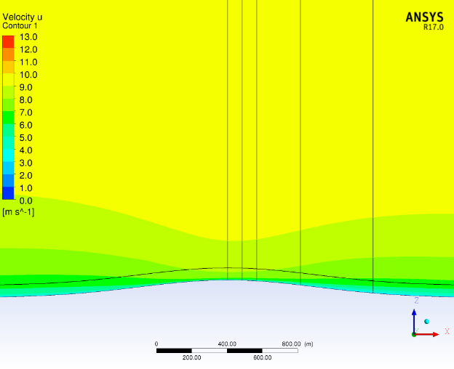
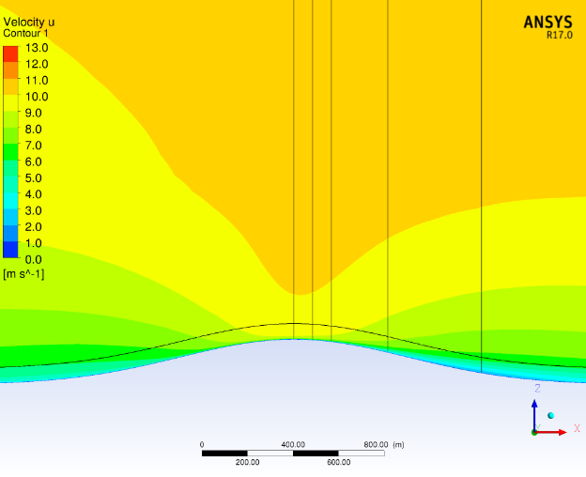
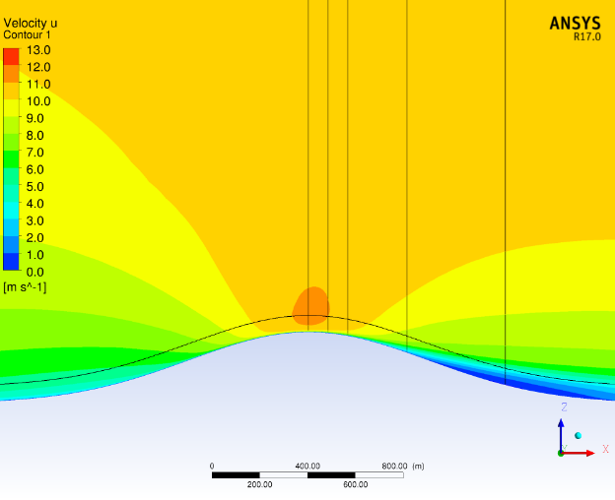
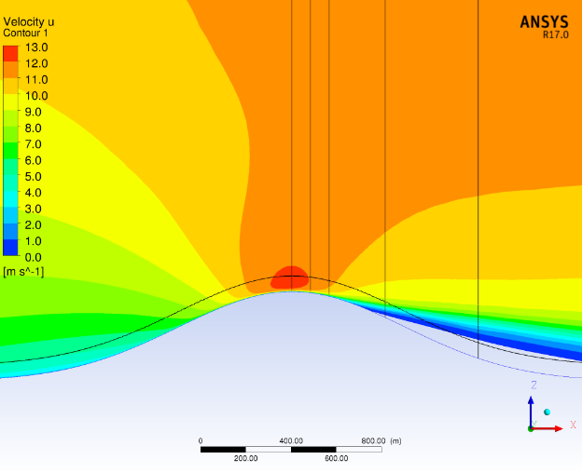
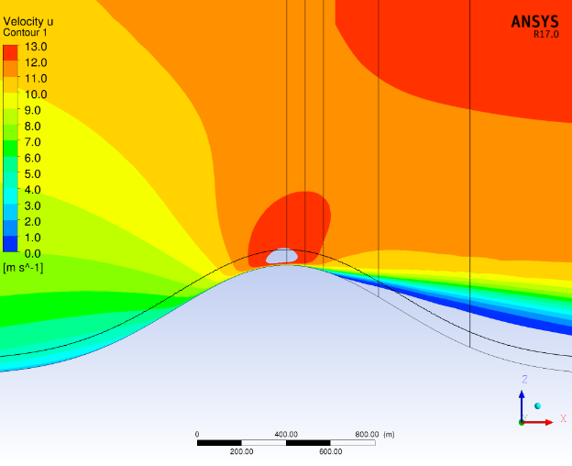
Stable conditions above boundary layer, neutral surface layer
H = 100m, max slope 12%, ~7°
H = 200m, max slope 24%, ~13.5°
H = 300m, max slope 36%, ~20°
U velocity component
Vertical lines @ hill top, 1D, 2D, 5D and 10D downstream of hill top
Terrain following line indicates hub height 70m above ground level (AGL)
Compared to purely neutral case :
Stronger speed up.
Reduced size of flow separation regions compared to purely neutral case.
H = 400m, max slope 48%, ~26°
H = 500m, max slope 60%, ~31°
Separated flow region below red line
Separated flow region below red line
Notes:
Critical angle for flow separation, 2D case, is about 18deg [Kaimal and Finnigan]

Slide 12
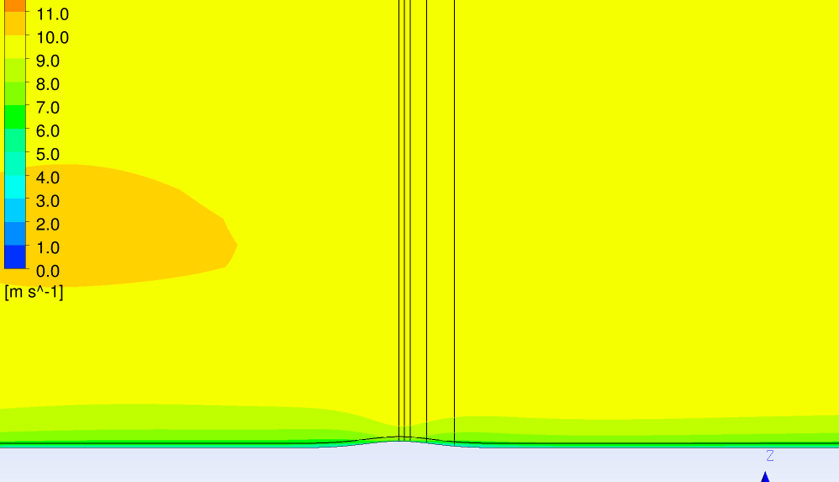
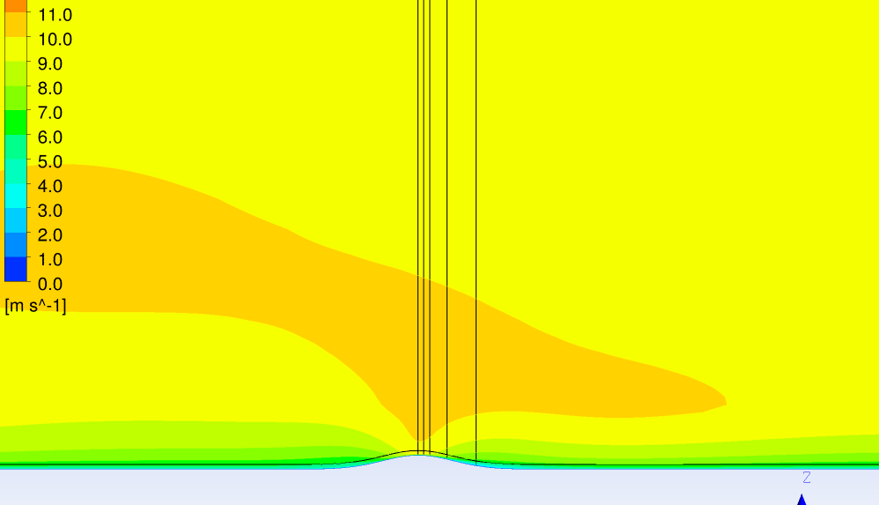
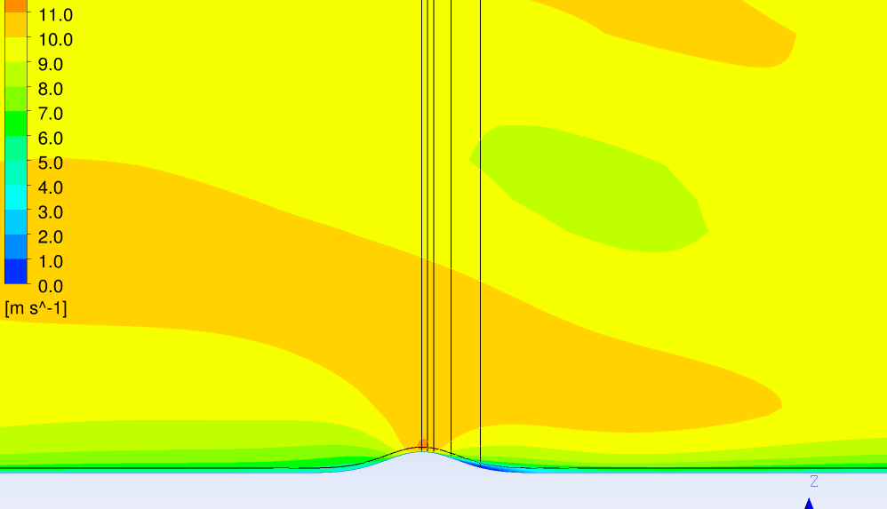
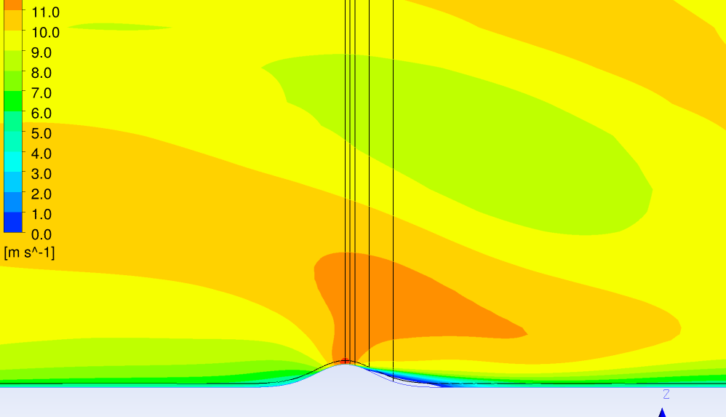
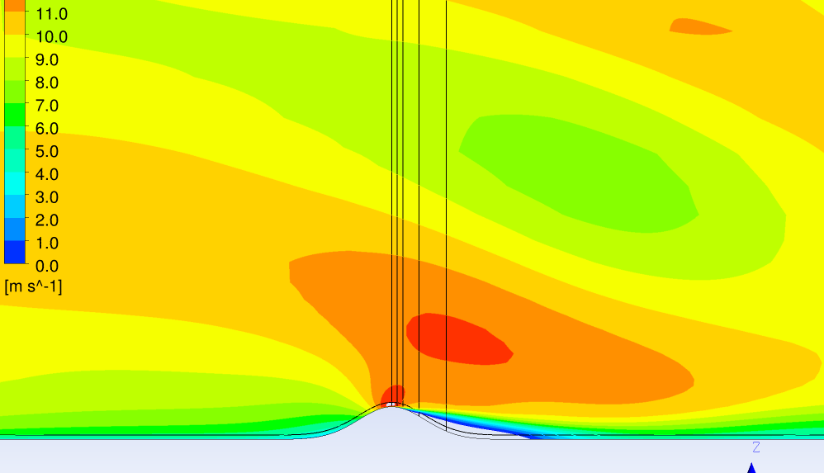
As previous slide, zoomed out, showing standing gravity waves
H = 100m, max slope 12%, ~7°
H = 200m, max slope 24%, ~13.5°
H = 300m, max slope 36%, ~20°
U velocity component
Vertical lines @ hill top, 1D, 2D, 5D and 10D downstream of hill top
Terrain following line indicates hub height 70m above ground level (AGL)
Compared to purely neutral case :
Stronger speed up.
Reduced size of flow separation regions compared to purely neutral case.
H = 400m, max slope 48%, ~26°
H = 500m, max slope 60%, ~31°
Notes:
Critical angle for flow separation, 2D case, is about 18deg [Kaimal and Finnigan]

Slide 13
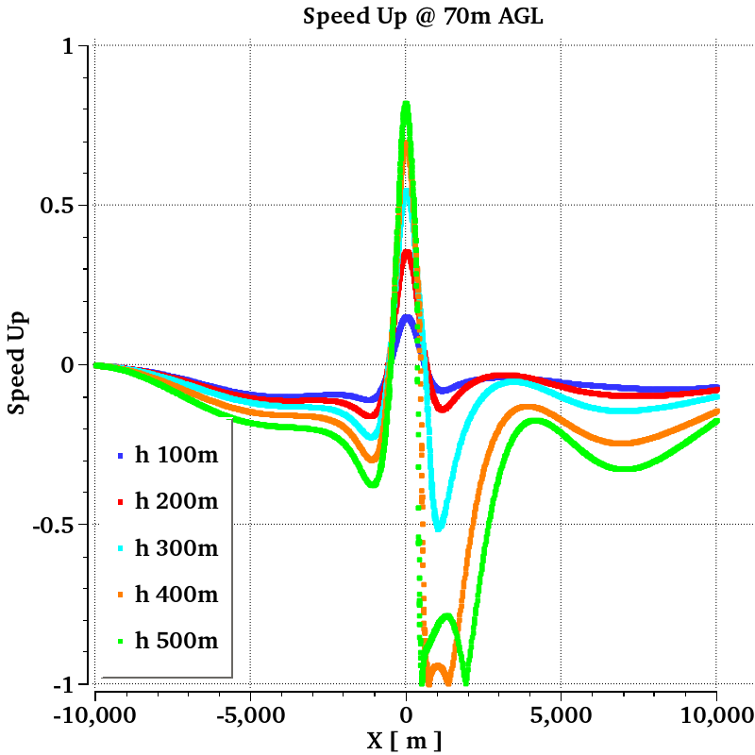
Stable conditions above boundary layer, neutral surface layer
Speed Up @ 70m AGL vs distance from hill top, for various hill heights. Compared to purely neutral case:
Blockage extends further upstream of hill
Speed up at hill top reaches higher values (> 80%), no longer saturates with increased hill height
Shorter separation regions for hill heights of 400 and 500m
Faster flow recovery downstream of the hill.
From gravity waves
$$SpeedUp\left(z_{AGL}\right)={\left[\frac{{Speed\left(z_{AGL}\right)−Speed}_{in}(z_{AGL})}{{Speed}_{in}(z_{AGL})}\right]}^{}$$

Slide 14
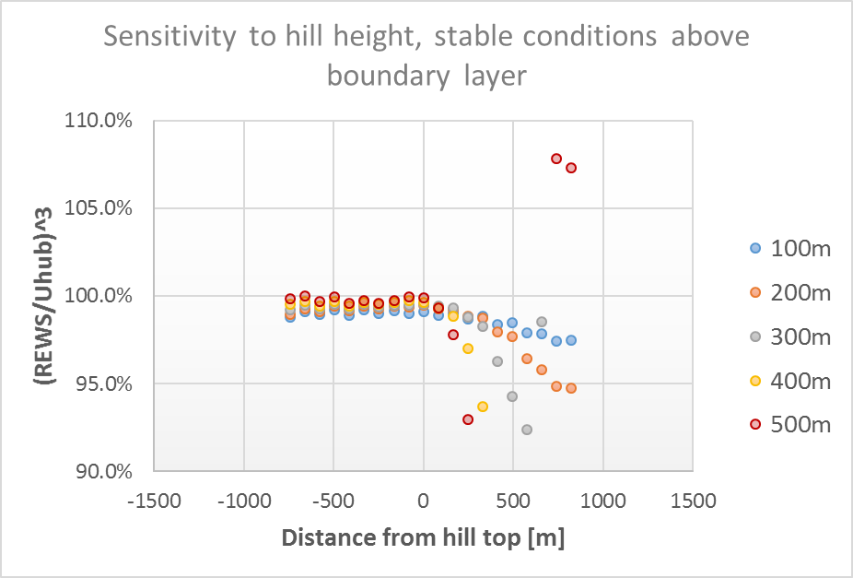
Stable conditions above boundary layer, neutral surface layer
Ratio of available energy through rotor from REWS and from hub wind speed, plotted vs distance from hill top, for various hill heights
Very similar result to purely neutral case, except for reach of separation region, and slightly reduced REWS/Uhub ratio for cases with separation
Available energy from hub height wind speed can exceed available energy in flow (from REWS) by up to ~ 5-7% in the wake of the hill.

Slide 15
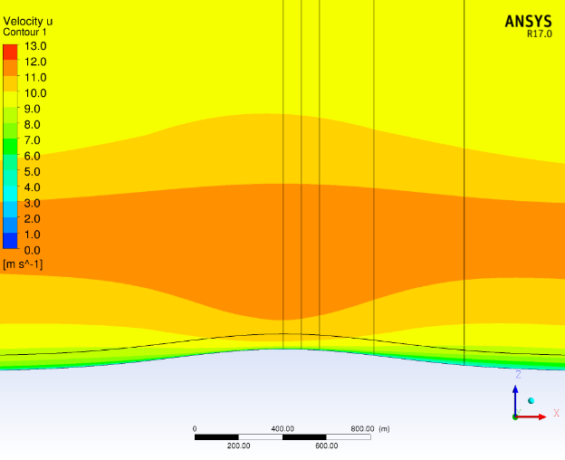
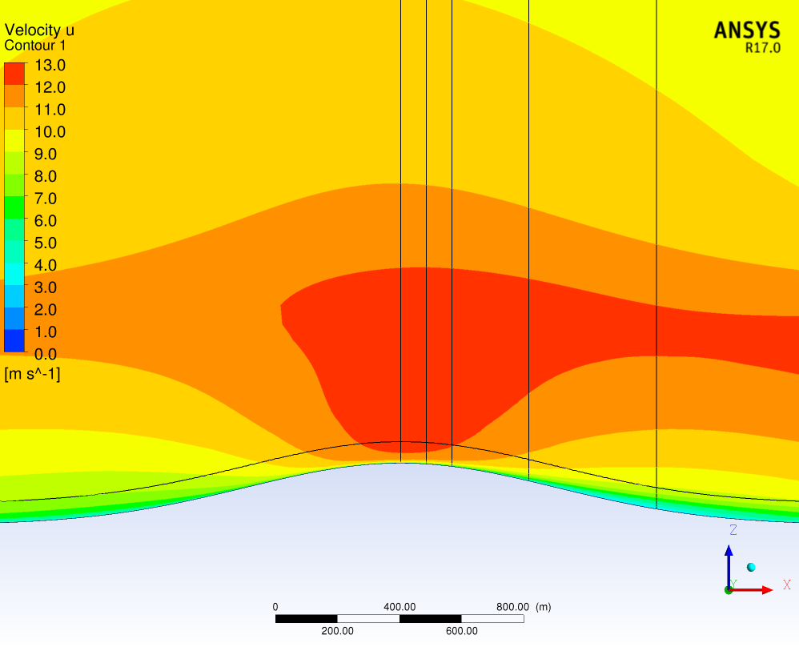
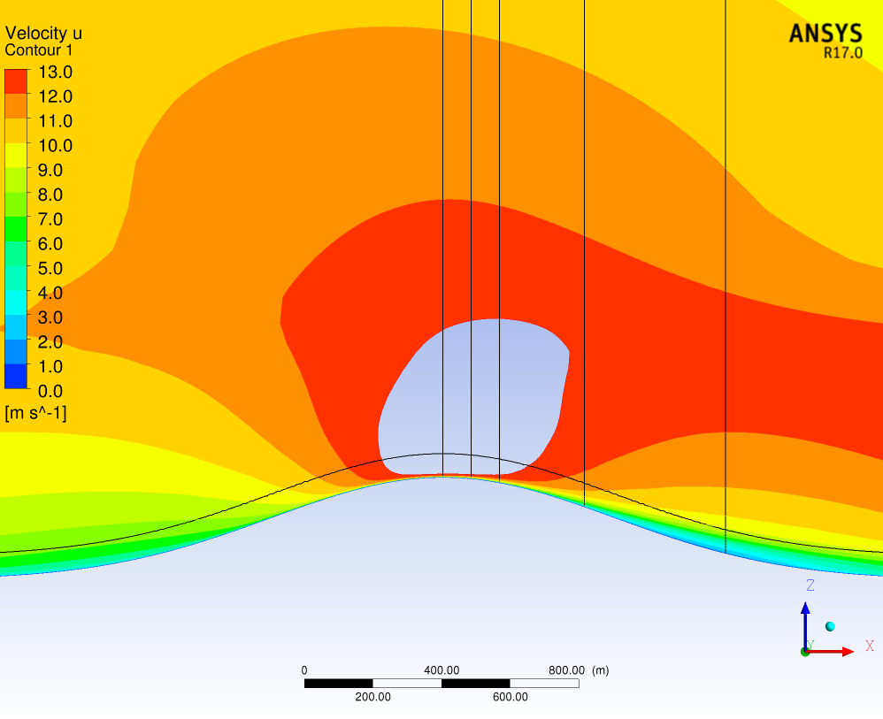
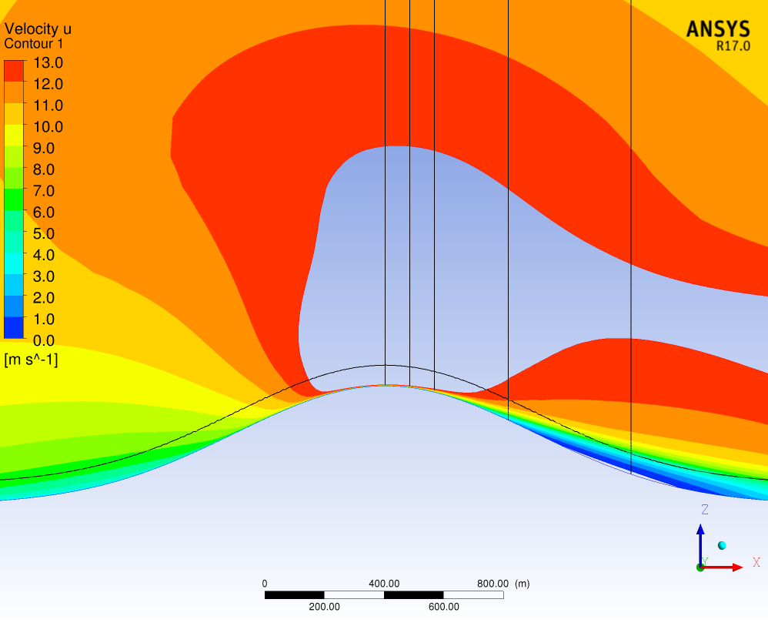
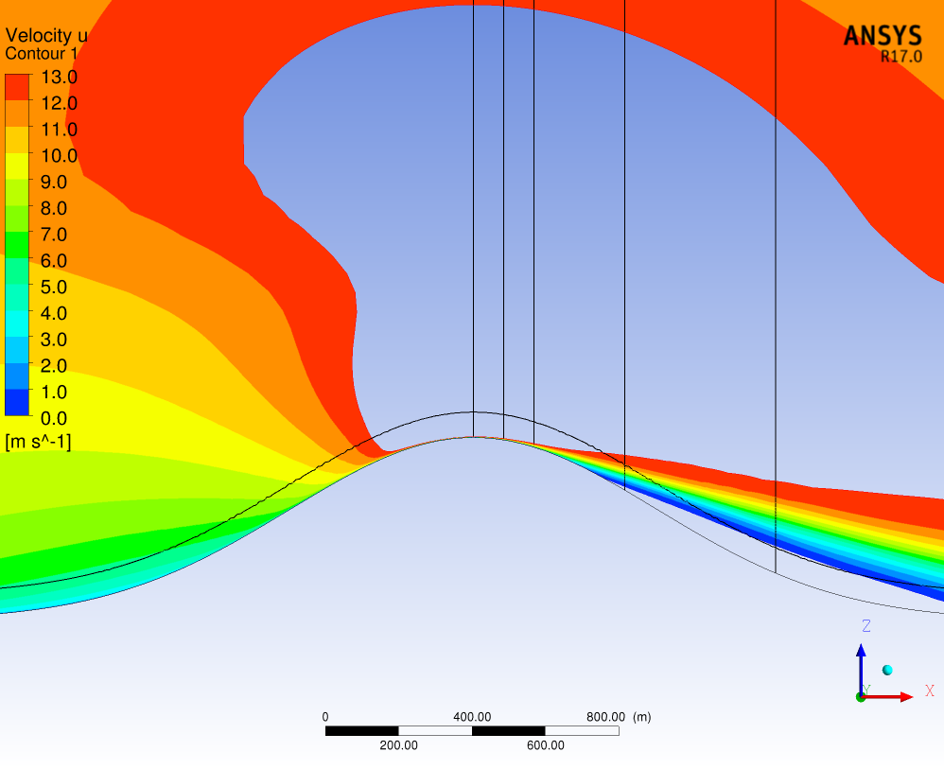
2K inversion below 1000m + low level jet
H = 100m, max slope 12%, ~7°
H = 200m, max slope 24%, ~13.5°
H = 300m, max slope 36%, ~20°
U velocity component
Vertical lines @ hill top, 1D, 2D, 5D and 10D downstream of hill top
Terrain following line indicates hub height 70m above ground level (AGL)
Compared to previous cases :
Much stronger speed up (beyond scale).
Much reduced size of flow separation regions (no separation for hill height of 300m).
H = 400m, max slope 48%, ~26°
H = 500m, max slope 60%, ~31°
Separated flow region below red line
Separated flow region below red line
Notes:
Critical angle for flow separation, 2D case, is about 18deg [Kaimal and Finnigan]

Slide 16
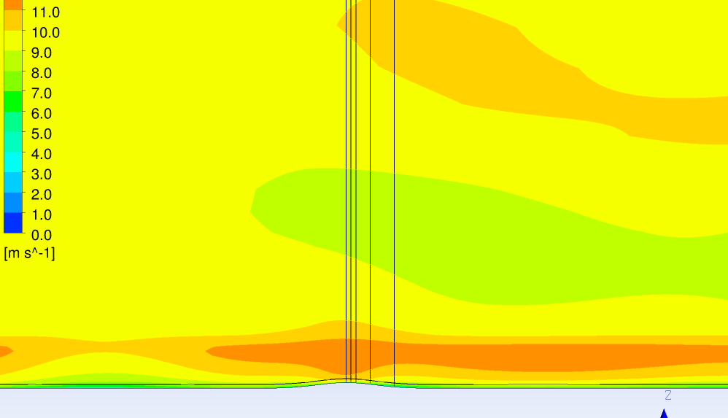
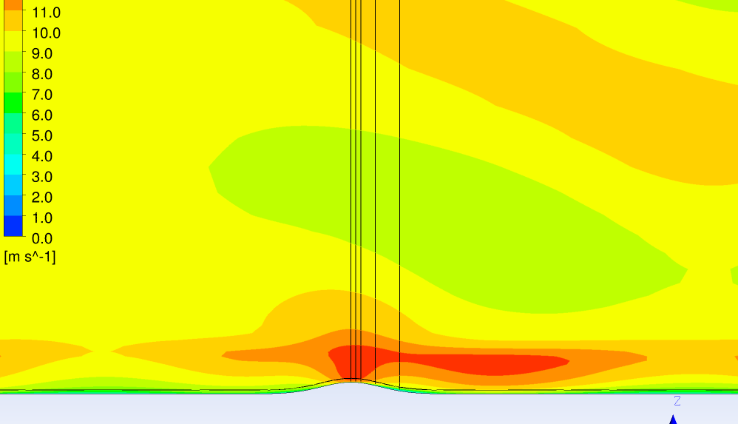
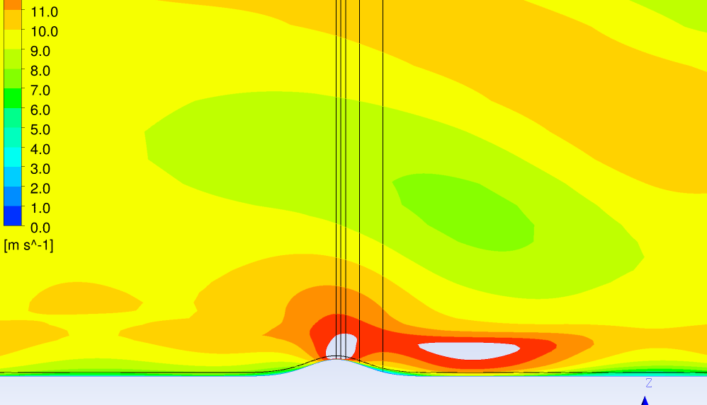
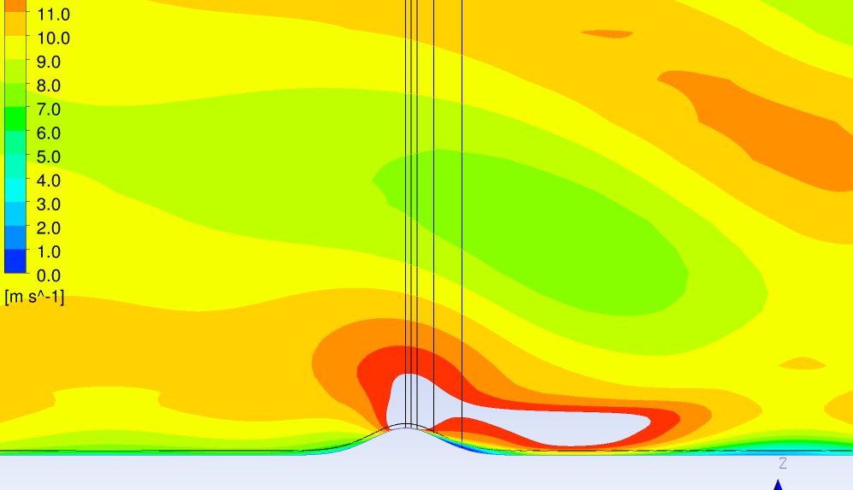
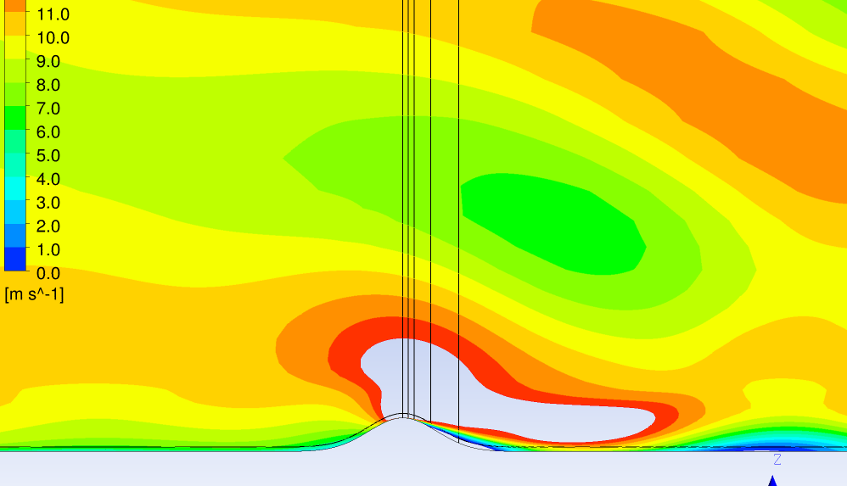
As previous slide, zoomed out, showing standing gravity waves
H = 100m, max slope 12%, ~7°
H = 200m, max slope 24%, ~13.5°
H = 300m, max slope 36%, ~20°
U velocity component
Vertical lines @ hill top, 1D, 2D, 5D and 10D downstream of hill top
Terrain following line indicates hub height 70m above ground level (AGL)
Compared to previous cases :
Much stronger speed up (beyond scale).
Much reduced size of flow separation regions (no separation for hill height of 300m).
H = 400m, max slope 48%, ~26°
H = 500m, max slope 60%, ~31°
Notes:
Critical angle for flow separation, 2D case, is about 18deg [Kaimal and Finnigan]

Slide 17
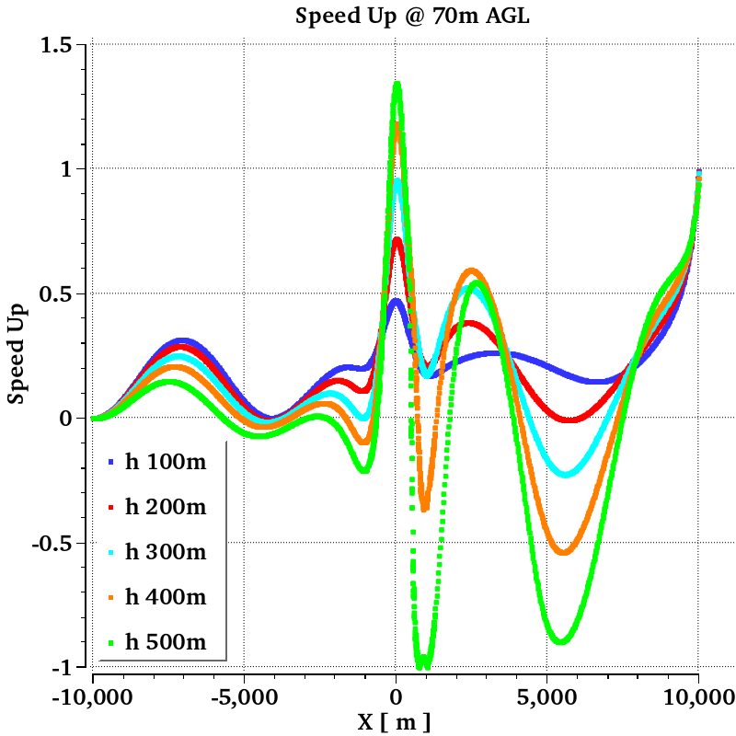
2K inversion below 1000m + low level jet
Speed Up @ 70m AGL vs distance from hill top, for various hill heights. Compared to purely neutral case:
Low level jet, acceleration downstream of inlet
Speed up at hill top reaches higher values (> 130%)
Separation @ hub height only visible for hill height of 500m
Strong oscillatory flow behaviour downstream of the hill (resonant gravity waves).
From gravity waves
$$SpeedUp\left(z_{AGL}\right)={\left[\frac{{Speed\left(z_{AGL}\right)−Speed}_{in}(z_{AGL})}{{Speed}_{in}(z_{AGL})}\right]}^{}$$

Slide 18
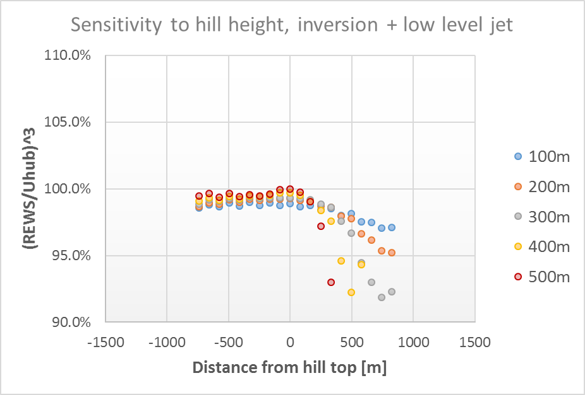
2K inversion below 1000m + low level jet
Ratio of available energy through rotor from REWS and from hub wind speed, plotted vs distance from hill top, for various hill heights
Similar result to neutral case, except with a tendency of further reduced ratios downstream of hill for cases with separation
Available energy from hub height wind speed can exceed available energy in flow (from REWS) by up to ~ 5-8% in the wake of the hill.

Slide 19
3D case, coastal transition

Slide 20
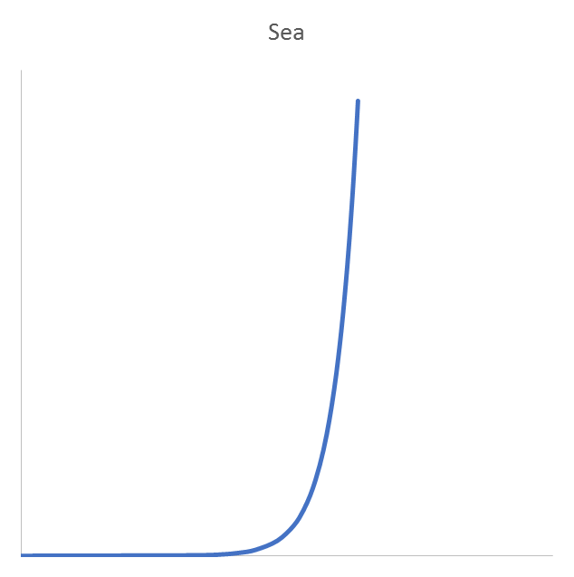
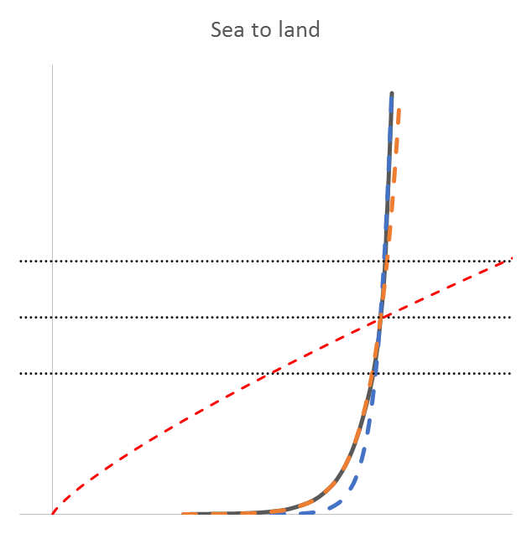
Coastal transition – sensitivity to surface stability
Equilibrium profile over sea
Land profile within IBL, sea profile above
Internal boundary layer height, h_{IBL}
z_{0s}
z_{0r}
sea
land
fetch, x
Effect of REWS = ?
with roughness transition
with roughness and thermal transition

Slide 21
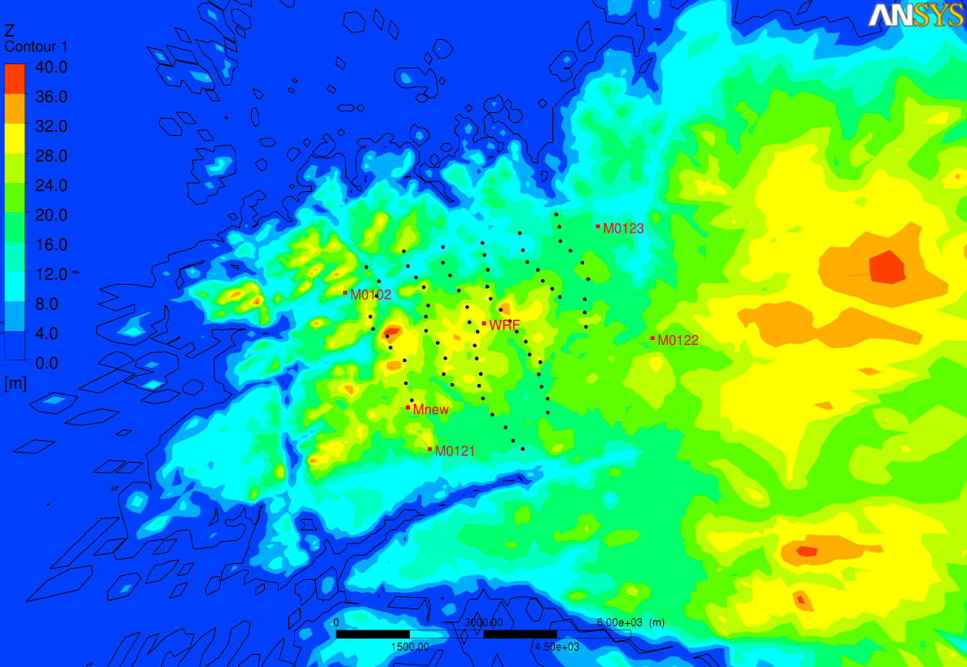
Real site: Smøla, Layout + terrain
Small terrain elevations
4 masts pre-construction
10m, 30m, 50m
1 mast post-construction
10m, 29m, 65m
Background info from
Håkansson & Sondell, ‘Measurements and power production’
Simulation details from
Montavon et al, 2015, EWEA Conference, Paris
Notes:
Fetch from Mnew to coast: ~ 5km for westerly directions
~ 10 km for south-westerly (depending on how many small islands we include)

Slide 22
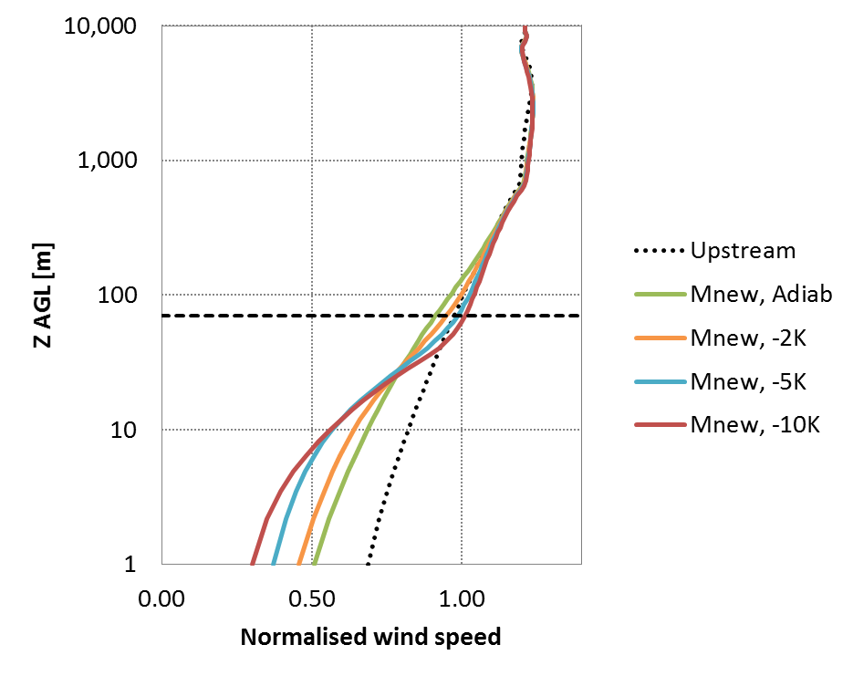
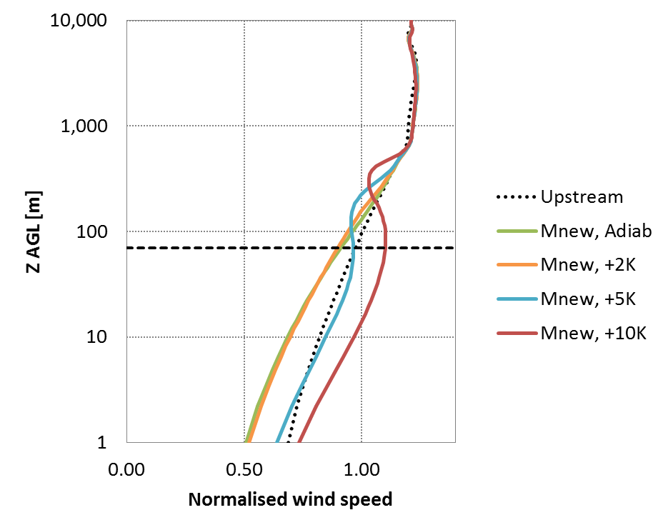
Normalised wind speed profiles at met mast location ‘Mnew’, sector 225, uref = 10 m/s @ 50m, sensitivity to dT
Stable conditions
Unstable conditions
From Montavon et al, 2015, Mind the energy gap: how coastal transition and stable atmospheric conditions affect velocity profiles, EWEA Conference Proceedings, Paris.
Horizontal dashed line: 70m AGL

Slide 23
Smøla : Sensitivity of REWS to surface stability associated with coastal transition, sector 225
Reduction of ratio between REWS and hub height wind speed because of the change in profile shape
Surface stability | (REWS/Vhub)³
Adiabatic | 98.5%
-2K | 96.9%
-5K | 95.7%
-10K | 95.8 %
Increasingly stable conditions downstream of transition
→ Stable cases: potentially significant overestimation of available power.
Notes:
Example: REWS to hub height wind speed, averaged over 68 turbine locations, Smola, sector 225.

Slide 24
Hypothetical site: Sensitivity of gross AEP (annual energy production) to the use of REWS
Site with 47 2.3MW turbines, 70m hub height, 82m diameter
Coastal transition (roughness and thermal discontinuity)
3 sets of surface stability conditions
Identical wind speed distribution (time series) for all stability conditions at an anemometer location at hub height
→ Gross AEP reduced when estimated from REWS rather than Hub Value
Only accounts for reduced available energy. Does not account for possible reduction in turbine efficiency due to non-optimal operating conditions.
Gross AEP [GWh/year] | Unstable, T contrast +5K | Neutral | Stable, T contrast -5K
REWS | 298.6 | 295.4 | 290.3
Hub Values | 304.9 | 297.6 | 301.4
Relative Δ | 2.1% | 0.8% | 3.8%
Notes:
Data derived from Smola, WT21-68, using time series from m121_50m, assuming it is valid at 70m.

Slide 25
Conclusions
From 2D case:
Ratio (REWS/Uhub)³ tends to decrease in wake of a hill (by up to ~ 5-6% for purely neutral conditions) → available power through rotor less than what would be estimated from hub wind speed
Reduction of REWS/Uhub ratio is slightly sensitive to stability conditions, and to change in flow regime in the presence of an inversion with low level jet (ratio reduced by up to ~7-8% with low level jet)
Speed up factor (in particular the ratio between the wind speed at the hill top and upstream of the hill) is very sensitive to changes in freestream stability and presence of low level jet:
Moderate hill size: Presence of freestream stability increases the contrast in speed up factor between hill top and hill base compared to purely neutral case → risk of overestimating AEP when ignoring free stream stability and using mast data measured near hill top.
Higher hill size: stability changes flow topology downstream of the hill.

Slide 26
Conclusions
From coastal transition case:
Ratio (REWS/Uhub)³ also sensitive to surface stability conditions
Starting from the same wind speed distribution at hub height, the gross AEP calculated from the REWS is lower than that calculated from hub height wind speed, for all surface stability conditions.
Reduction is strongest with stable surface conditions downstream of the coastal transition.

Slide 27
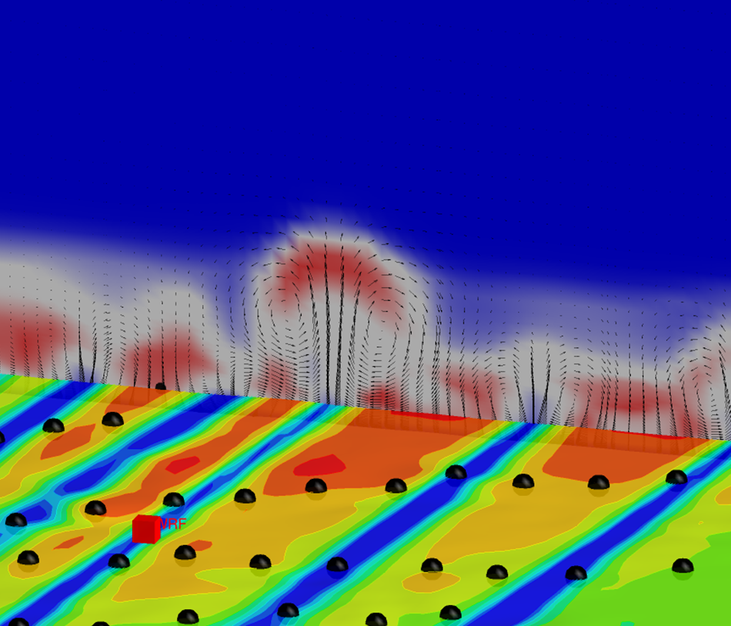
Thank you
M. Hakansson & N. Sondell, Statkraft
P. Housley & C. Rodaway, SSE
For more info on WindModeller please contact: christiane.montavon@ansys.com

Slide 28
Additional material

Slide 29
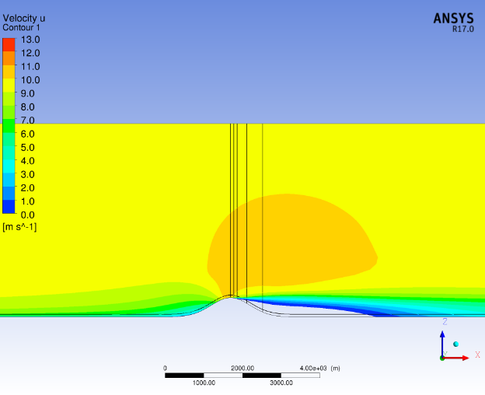


Distribution of U velocity in vertical plane for various stability conditions
H = 500m, purely neutral
H = 500m, stable above boundary layer
H = 500m, inversion + low level jet
U velocity component
Vertical lines @ hill top, 1D, 2D, 5D and 10D downstream of hill top
Terrain following line indicates hub height 70m above ground level (AGL)
Gravity waves visible when modelling free stream stability are not seen in purely neutral case.
These are responsible for the change in wind speed distribution in the wake of the hill. The case with inversion and low level jet shows a resonant gravity wave which causes a flow acceleration downstream of the hill, with a quiet region further downstream. The flow acceleration in the lee also reduces the size of the separation region.
Note: the real atmosphere is not purely neutral, even when the surface conditions are neutral. To capture these effects, it is necessary to include the buoyancy term in the vertical velocity equation. (modelling the effect of surface stability by parameterizing the effect of stability on the mixing in the surface layer will not help capture these).

